Slide 1
eBooks for Everyone
Strictly Confidential. Copyright Vook, Inc. All Rights Reserved

Slide 2
What is Vook?
Vook is a cloud-based technology platform that enables
fast and efficient ePublishing, eDistribution and eMarketing of books, blogs, videos and other content through major marketplaces and directly to consumers

Slide 3
Battle Tested Platform
3.1million
Downloads
10,000
2,762
100
1day
Market-places
Titles
Partners
To Build

Slide 4
Great Partners
Major Publishers
MidRange Publishers
News Organizations
Television Networks
Technology Companies
Other Industries
Bloggers and Authors
Distributors

Slide 5
Ride the Wave of eBook Growth
43% of Americans have read an eBook
20 million people read eBooks in 2011
114 million units sold in 2010
Kindle Singles sold over 2 million units
eBooks are a $6.5 billion market

Slide 6
Monetize New and
Archival Content
Archival Content
JFK
Eat to Live
Blogs into Books
Scam School
Just-In-Time
Publishing
Herman Cain

Slide 7
Produce Fast and Efficiently
The Old Way
The Vook Way
Design: 2 weeks, $1000
Conversion: 8 weeks, $500
Enhancement: 1 week, $200
Marketing: 6 weeks, $4,500
QA: 3 weeks, $200
Distribution: 6 weeks, $400
Tracking: 2 weeks, $200
Inspiration
Distribution
72 hours
3 months
$7,000

Slide 8
Sell Through Existing Channels
99%
of Existing Market

Slide 9
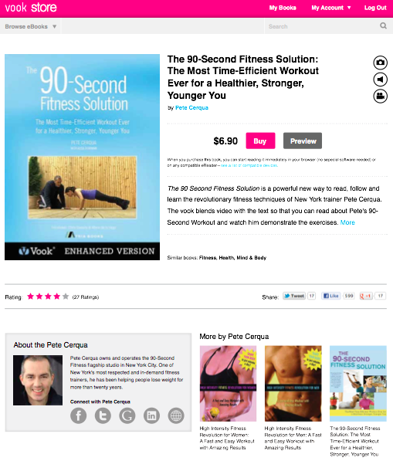
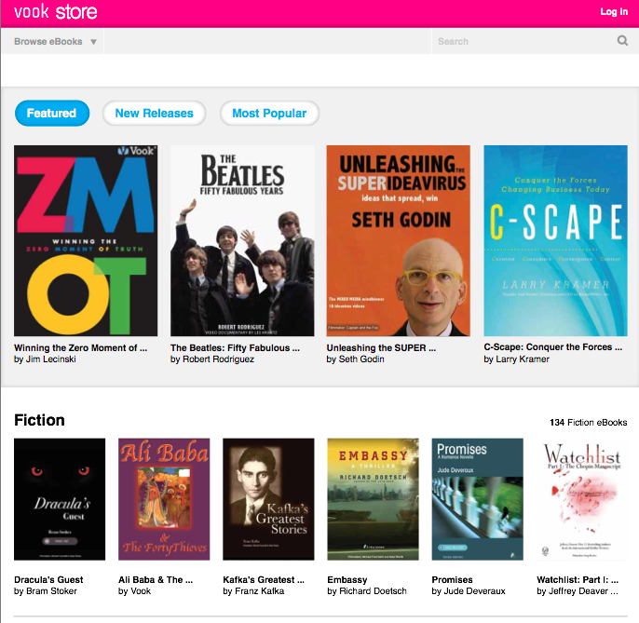
Create Compelling Storefronts

Slide 10
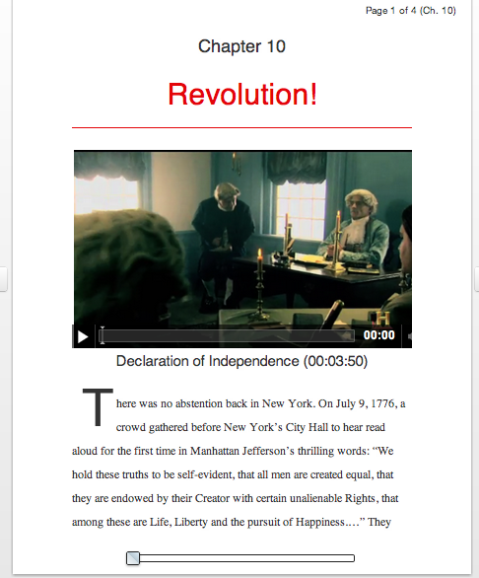
Sell Direct with HTML5

Slide 11
Three Case Studies

Slide 12
Case Study:
Wall Street Journal & Vook
New opportunity for long form stories
Content, talent and will on staff
eBooks = the new blog software
Format outlasts news cycle
Dedicated existing audience

Slide 13
Thought Leadership:
Google’s Zero Moment of Truth
200,000 + downloads
Enhanced eBook with video and links
Web & retail distribution
Free price point
Extensive press, blog & conference spots

Slide 14
Brand Development:
Ernst & Young’s Global Banking
Narrowly targeted content
Produced their own Web experience
Audio elements add more value
Reinforced brand position
Innovative but easily accessible

Slide 15
Three Keys to eBook Success

Slide 16
Clear Branding & Covers:
Brief Histories & Gaiam

Slide 17
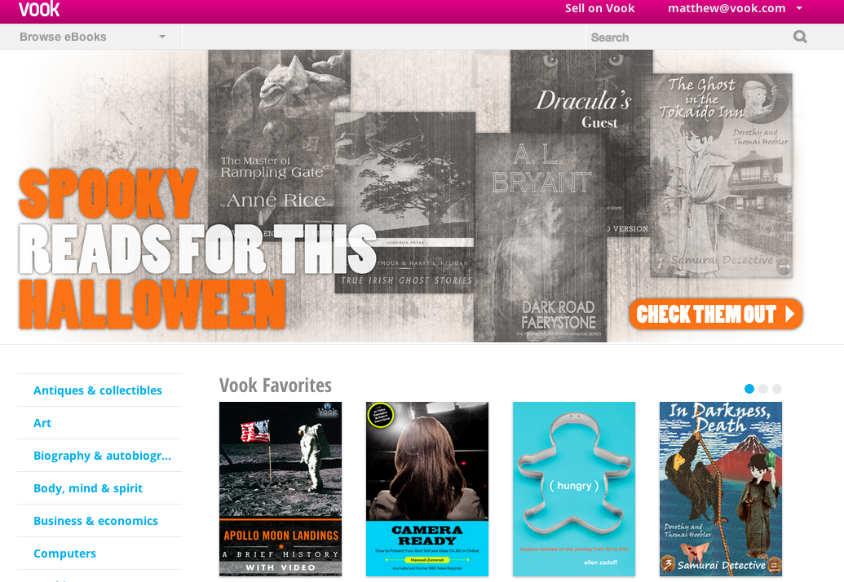
Direct Sales: Vook Store
Confidential

Slide 18
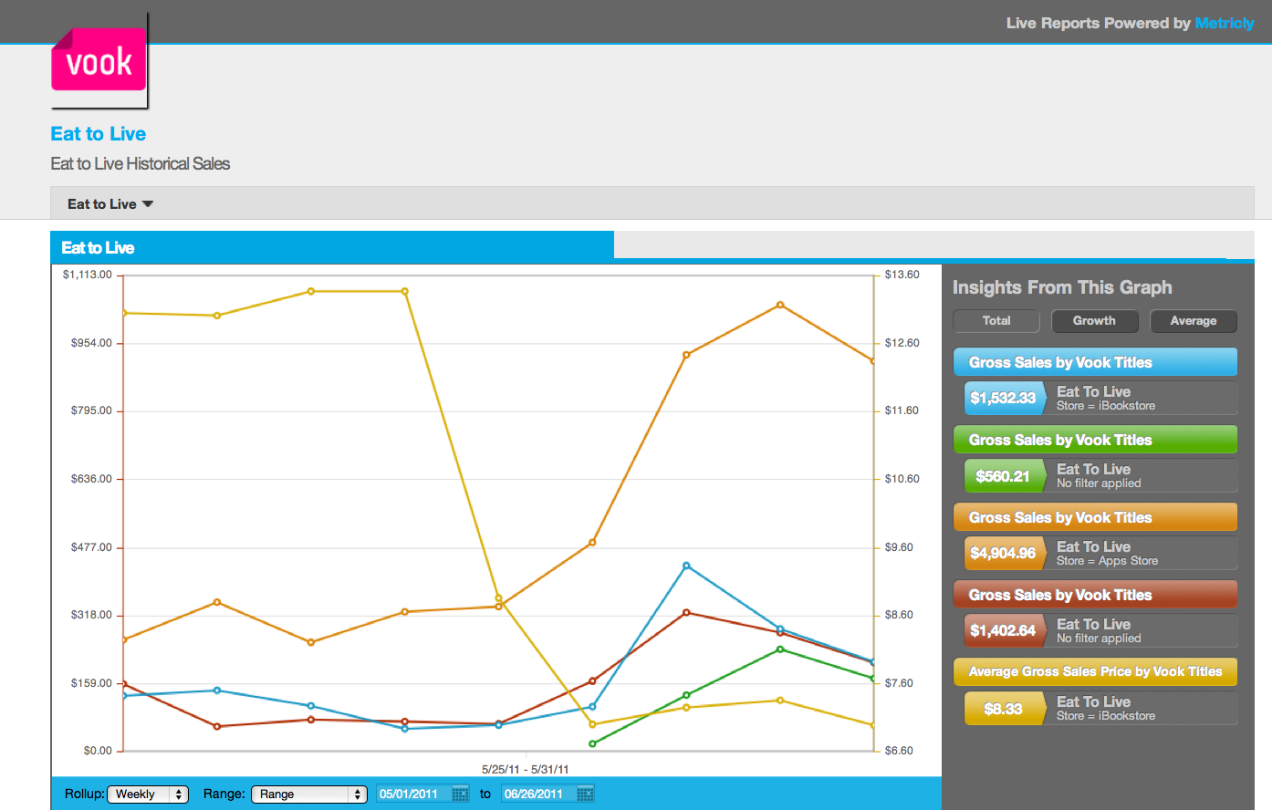
Reporting & Metrics: Analytics

Slide 19
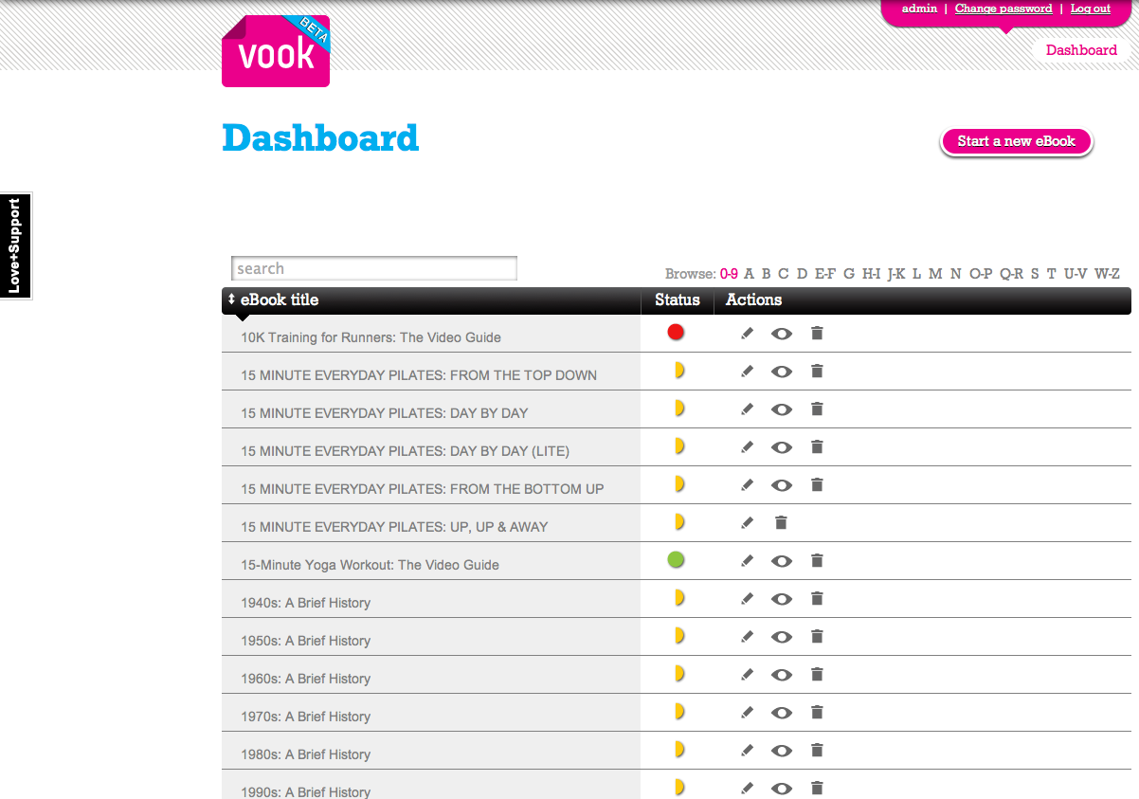
Scale Quality: Catalogs

